Slide 1
GAME
DEVELOPMENT
101

Slide 2
PRE
PRODUCTION
POST
PRODUCTION
DESIGN
PROCESS
QA / TESTING
DEVELOPMENT

Slide 3
Components of a game
UI
Audio
Shaders
Gameplay
Code
VFX
Game Engine
Story
Rendering

Slide 4
Programming
Design
SKILLS
Maths /
Physics
Creativity
Notes:
What skills do you need to become a good gameplay programmer?

Slide 5
Pre-built game engine
Develop a game engine

Slide 6
Why do I need a pre-built game engine?
Graphics Engine
Physics and Maths
Input
Animation
Sound
Networking
AI
Memory Management
Scene Management Data Structures
Particle Systems
Lighting
Scripting
Notes:
View Frustum Culling This is used to test if an object is in the field of view of the player’s camera before rendering it in order not to render unnecessary geometry.

Slide 7
Why do I need a pre-built game engine?
Community
Learning Resources
Active Development
Tools / Extensions /Plugins

Slide 8
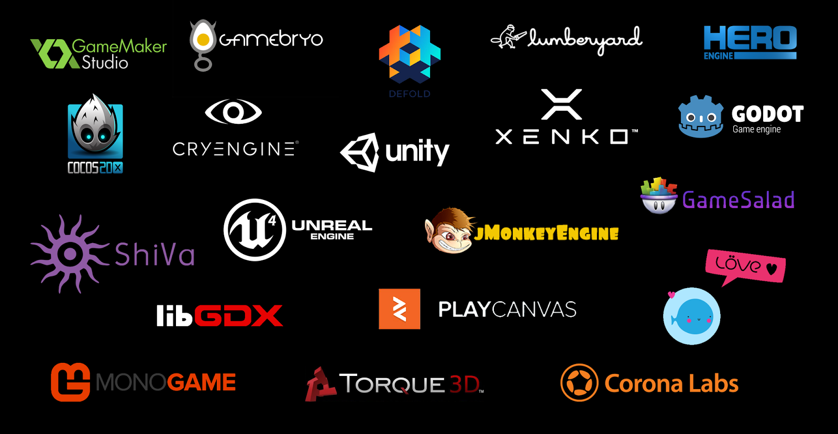
Notes:
Factors to take into account before selecting a game engine
- Camera View/Game Dimension
- Genre
- Development Machine Specs
- Platform or Target Hardware
- Programming Language
- Ease of use
- Licensing
- Application Size
- Learning Curve
- Extra Benefits

Slide 9
Why did I choose Unity for this workshop...

Slide 10
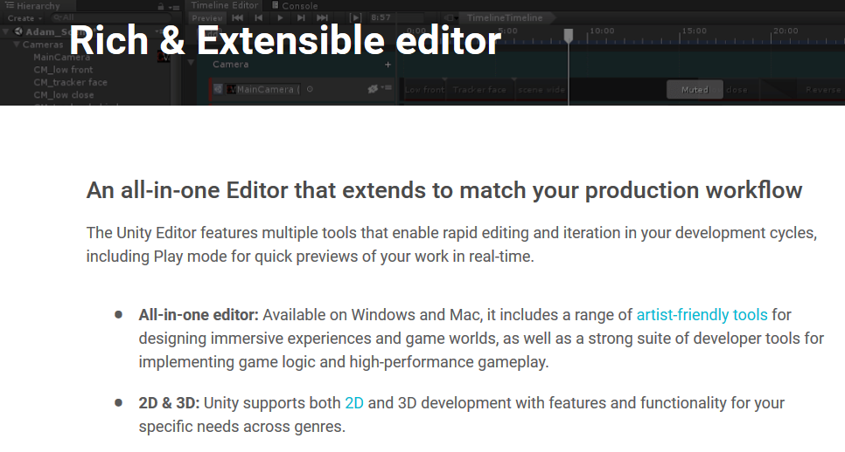

Slide 11
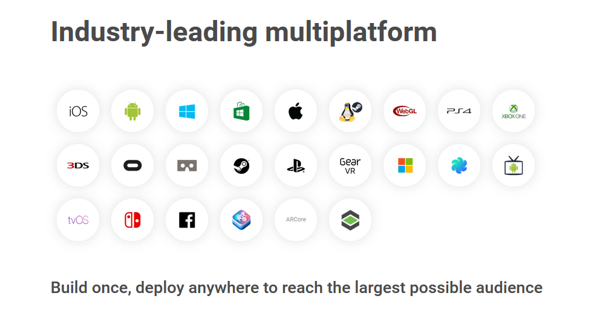

Slide 12
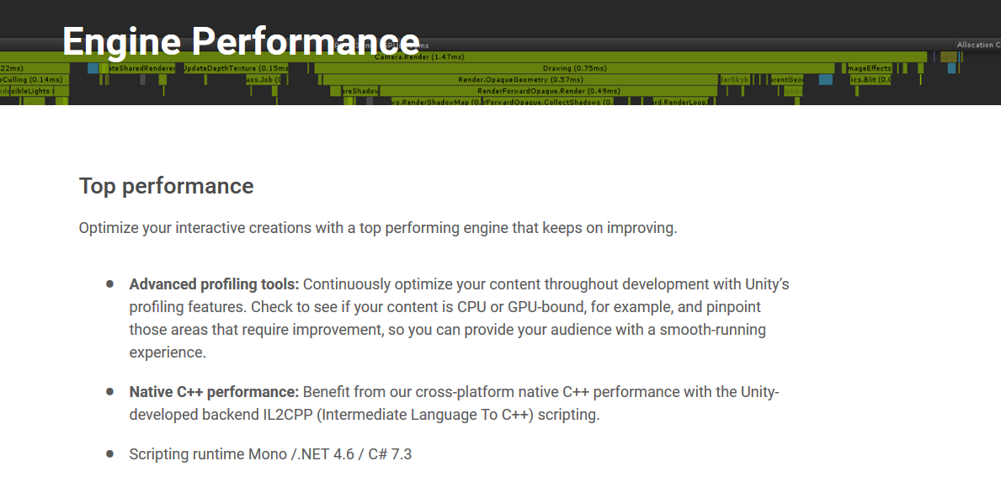

Slide 13
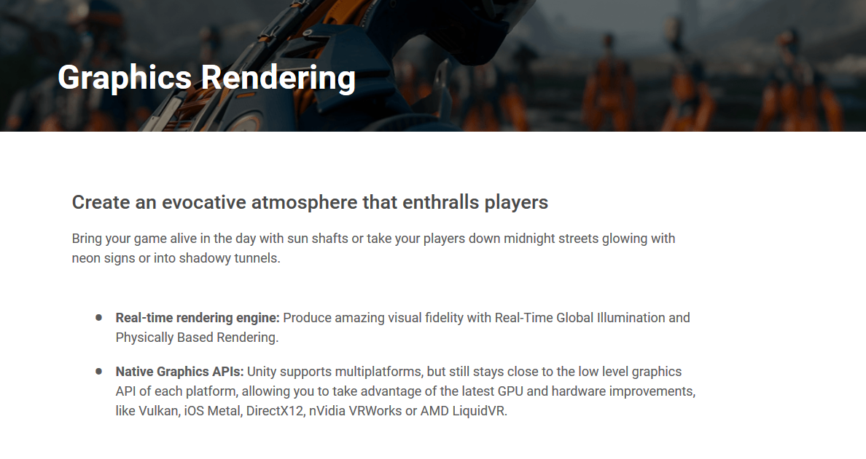

Slide 14


Slide 15
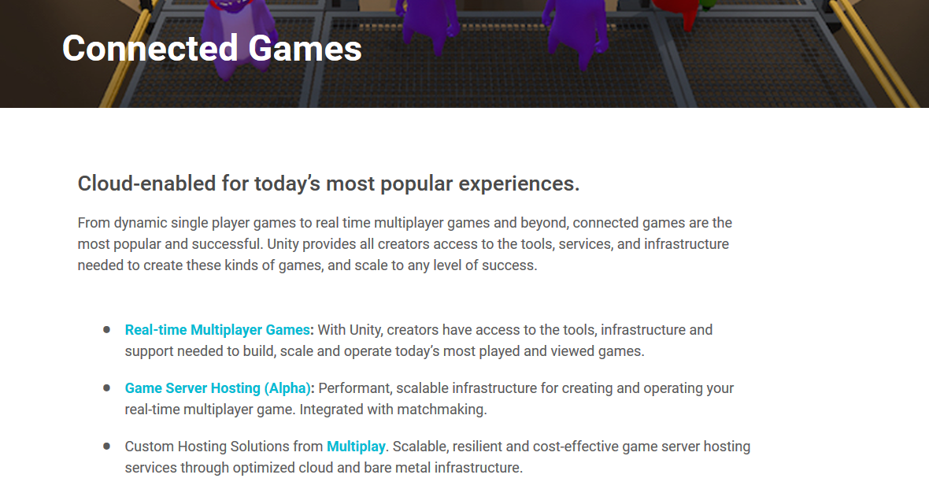

Slide 16
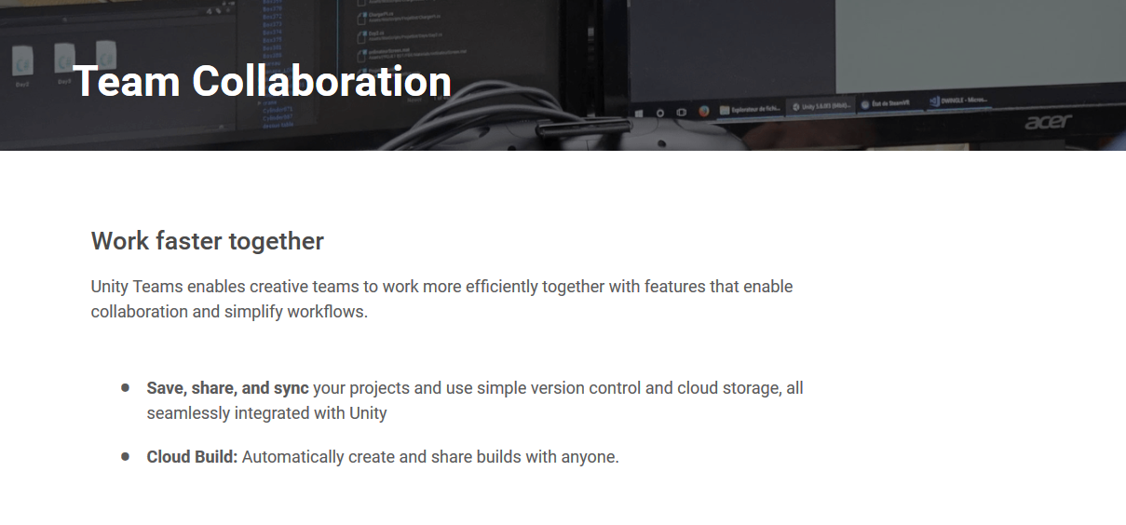

Slide 17


Slide 18
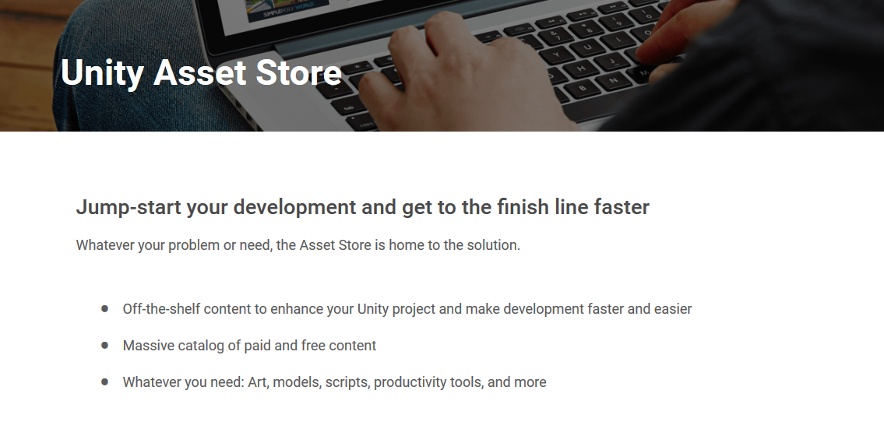

Slide 19


Slide 20
Demo video...
Notes:
Unity Capability

Slide 21

Notes:
Unity Capabilities

Slide 22

Notes:
Unity Capabilities

Slide 23
Questions?

